Slide 1
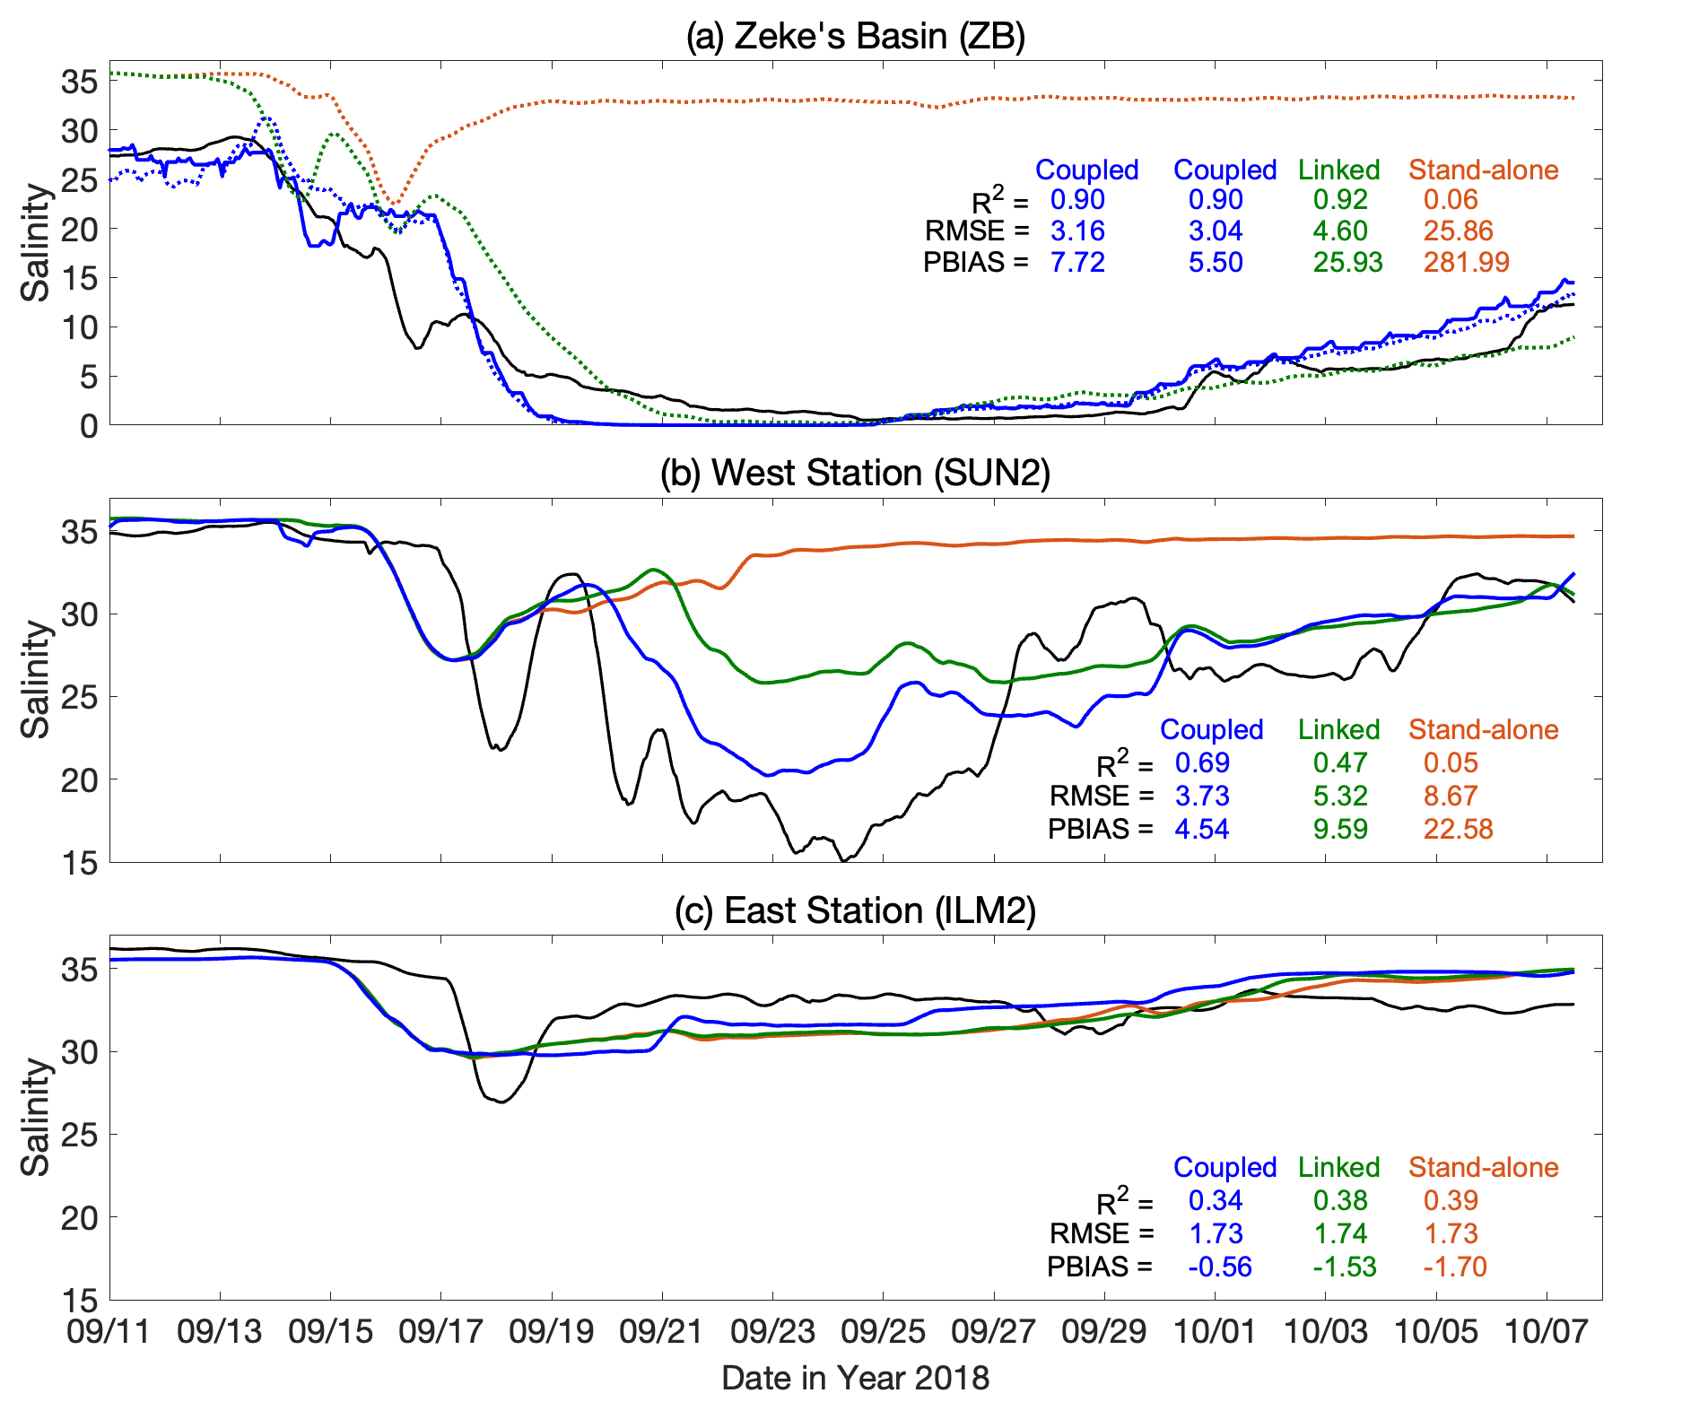
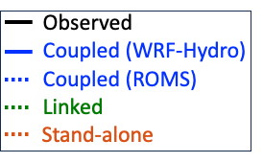
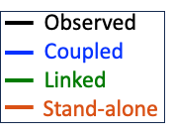
Figure 4.
ZB station (WRF-Hydro)
Estuarine Water (ROMS)

Slide 2
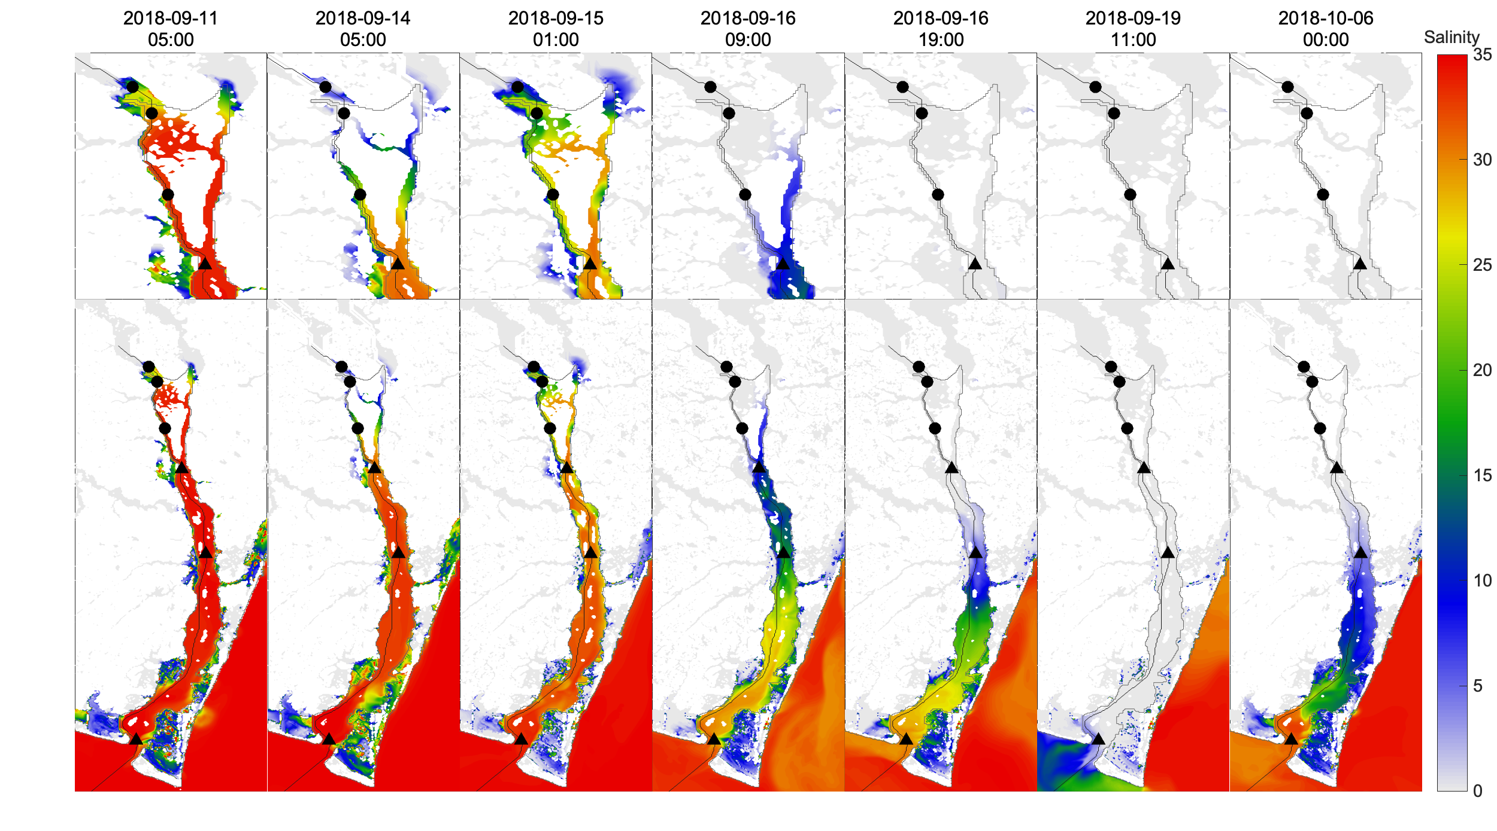
Figure 6.
(a)
(b)
(c)
(d)
(e)
(f)
(g)
LE1
LE2
LE3
ES1
(h)
(i)
(j)
(k)
(l)
(m)
(n)
LE1
LE2
LE3
ES1
ES2
ES3

Slide 3
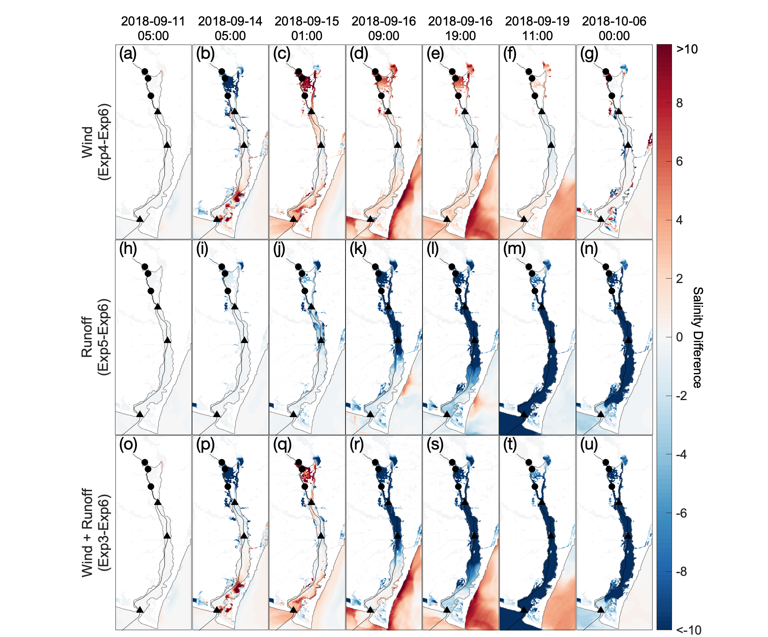
Figure 7
LE1
LE2
LE3
ES1
ES2
ES3

Slide 4
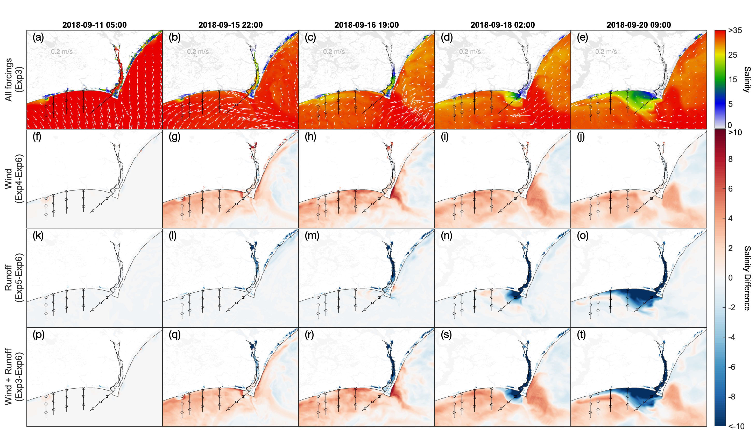
Figure 9.
Inlet 1
Inlet 2
Inlet 3
Inlet 4
EO1
EO2
EO3

Slide 5
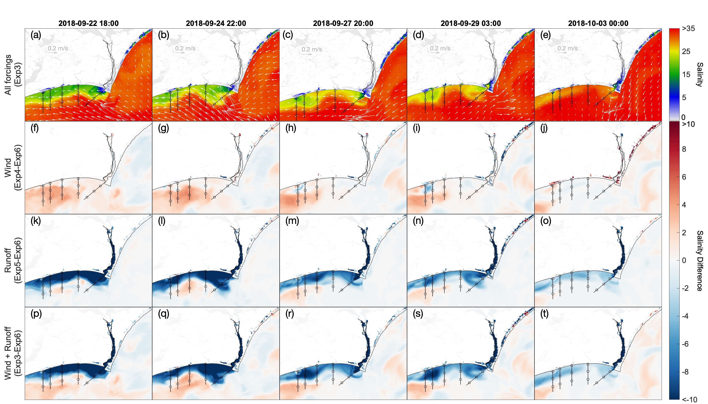
Figure 10.
Inlet 1
Inlet 2
Inlet 3
Inlet 4
EO1
EO2
EO3

Slide 6
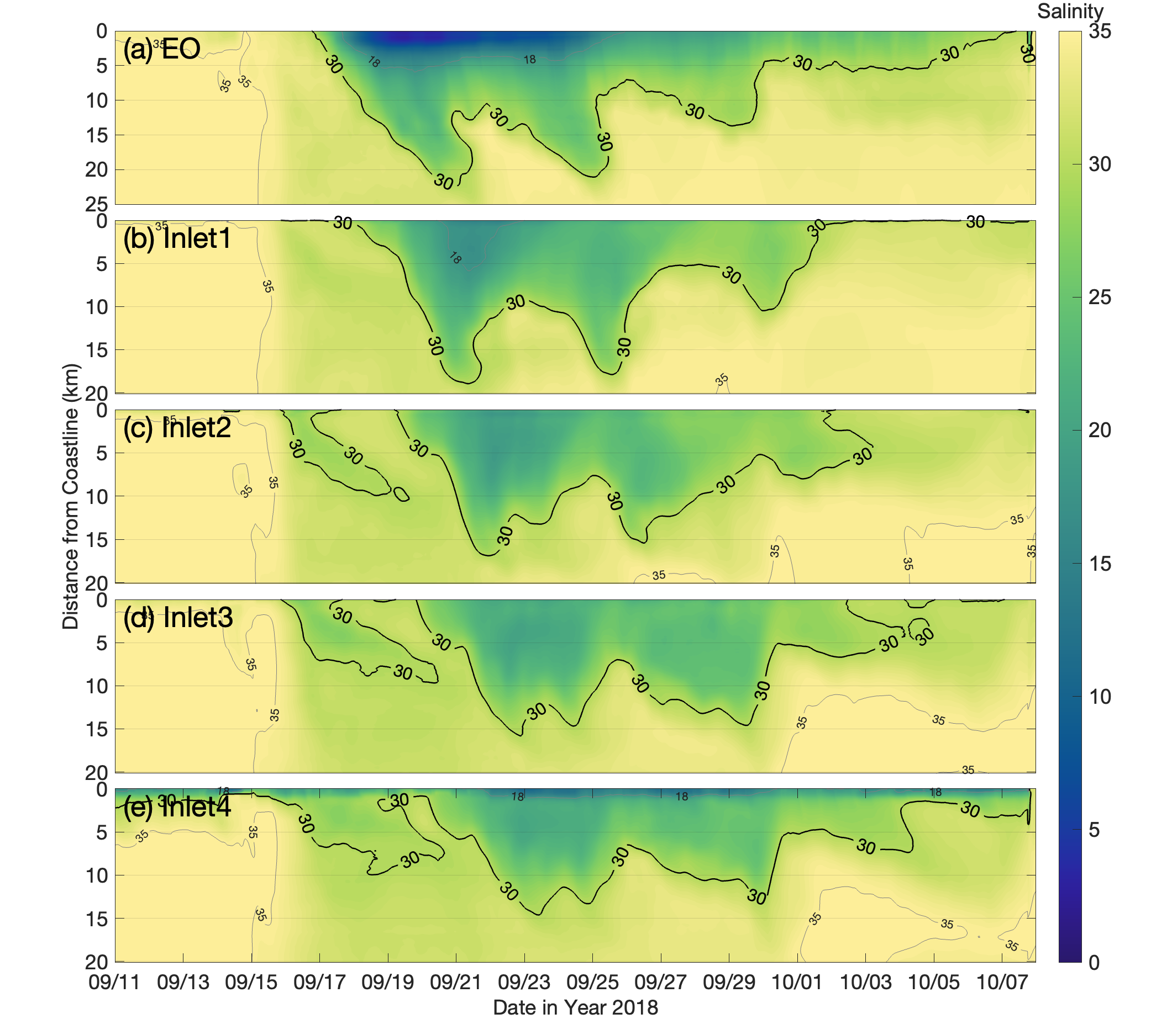
Figure 11.
Freshwater
Plume Onset

Slide 7
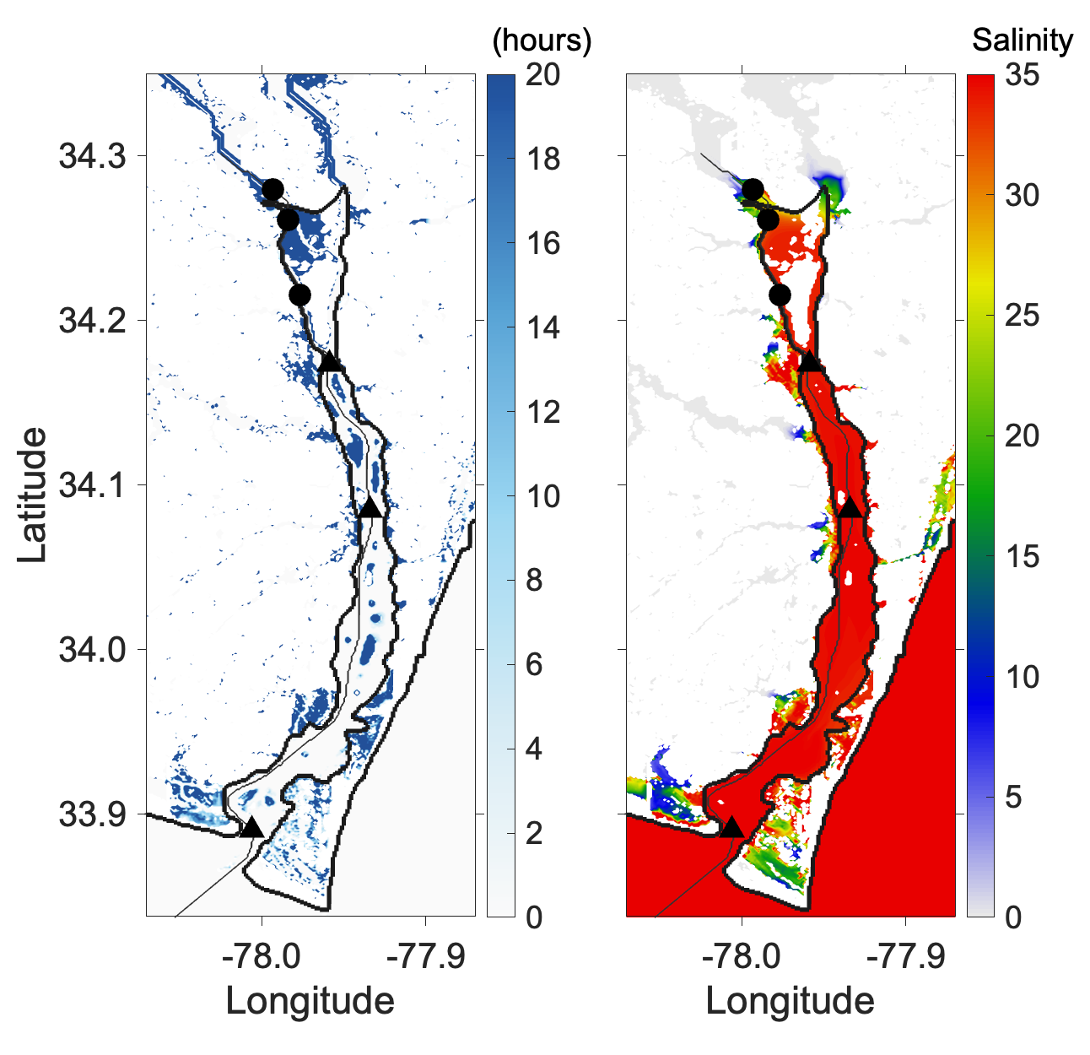
Figure 12.
(a)
(b)
LE1
LE2
LE3
ES1
ES2
ES3

